Slide 1
PRINCIPLES OF GLOBAL ECONOMICS
Chapter 21: Income Inequality and Poverty

Slide 2
Preview
Up to this point, we primarily analyzed the efficiency of markets:
In general, a market is efficient in the sense that it maximizes total surplus in the economy.
But we have not discussed how that surplus is distributed between consumers and producers.
We also have not examined how consumer surplus is distributed among consumers or how producer surplus is distributed among producers.
Recall that a monopoly with perfect first-degree price discrimination was considered “efficient.”
Coasean bargaining solutions where one party takes all the surplus were also considered “efficient.”
In this chapter, we turn to a different topic: Inequality
How much economic inequality is there in society?
How many people live in poverty?
What problems arise when measuring inequality and poverty?
How often do people move between income classes?

Slide 3
Inequality and Poverty

Slide 4
Quintile Ratio
One way to measure inequality in a country is to examine earnings across quintiles.
Each “quintile” represents one fifth of the country’s population.
Based on income:
The lowest quintile is the bottom 20 percent of earners in the economy.
The top quintile is the top 20 percent of earners in the economy.
According to the U.S. Census, as of 2024 the household income of each quintile is:
Lowest Quintile: Under $34,510
Second Quintile: $34,510 - $65,100
Third Quintile: $65,100 - $105,500
Fourth Quintile: $105,500 - $175,700
Top Quintile: Above $175,700

Slide 5
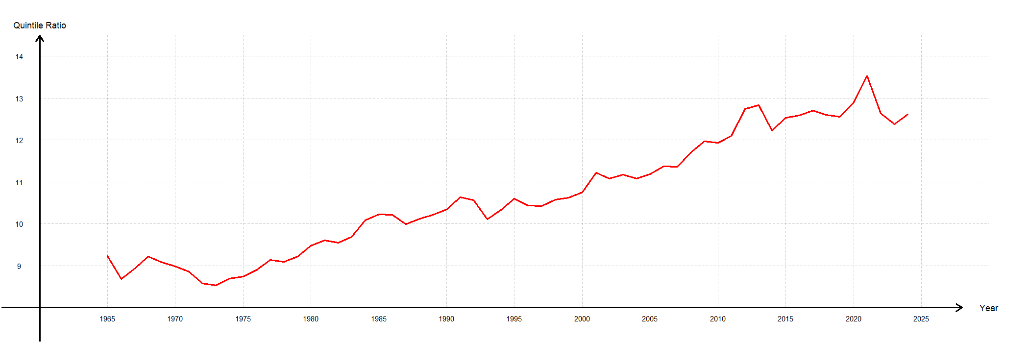
Quintile Ratio
The quintile ratio is the income share of the highest quintile (top 20% of earners) divided by the income share of the lowest quintile (bottom 20% of earners).
The current value is 12.61, which means that the top quintile receives more than twelve times the share of total income received by the bottom quintile.

Slide 6
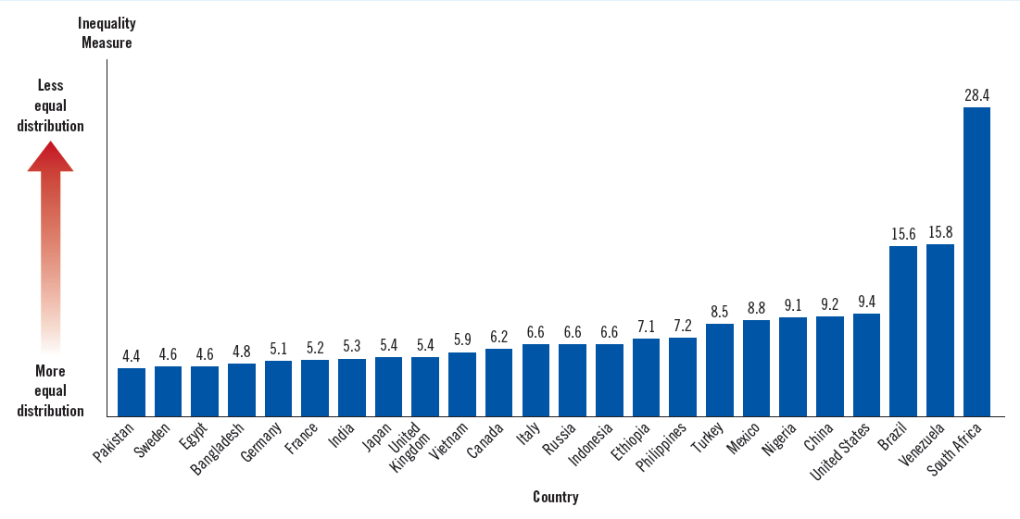
Quintile Ratio: Global Comparison

Slide 7
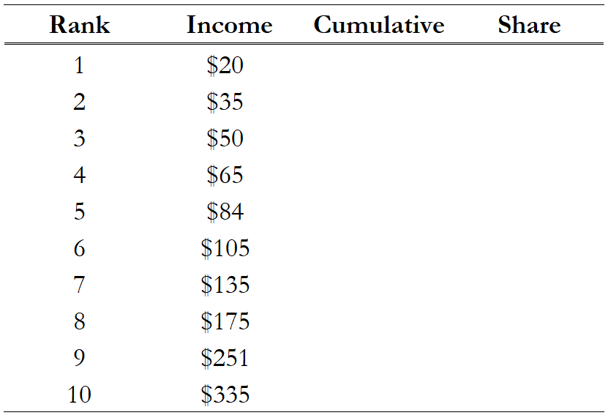
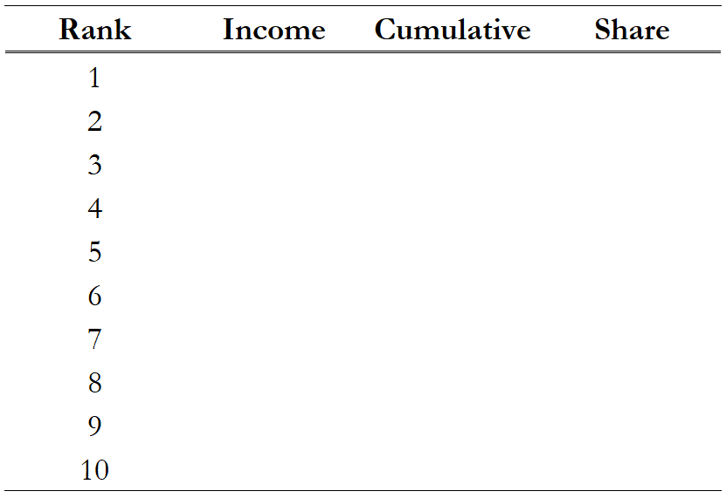
The Lorenz Curve and the Gini Index
Another well-known method of measuring income inequality is the Gini Coefficient.
To illustrate how to calculate the Gini Coefficient, we imagine a society of 10 people.
Suppose we record each individual’s income and rank them from the lowest earner to the highest earner.
Then we calculate the cumulative income up to the Nth earner.

Slide 8
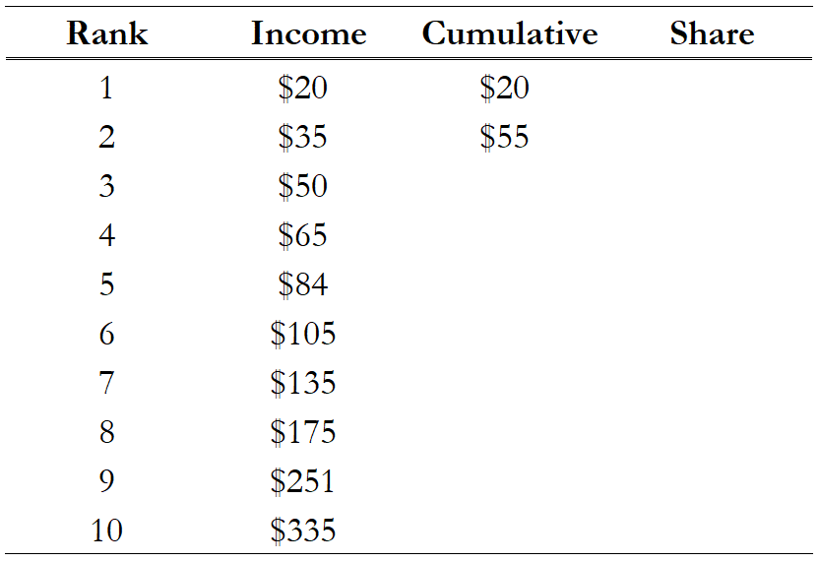
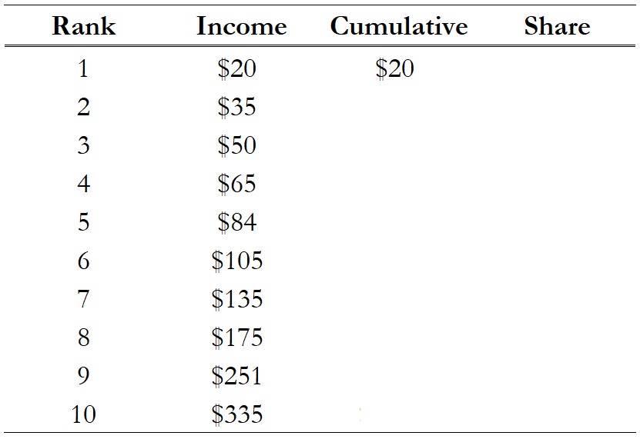
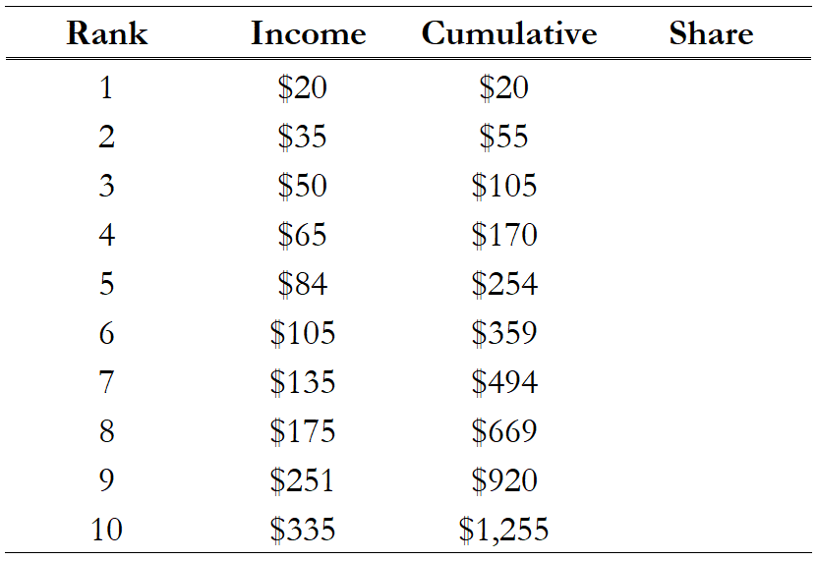
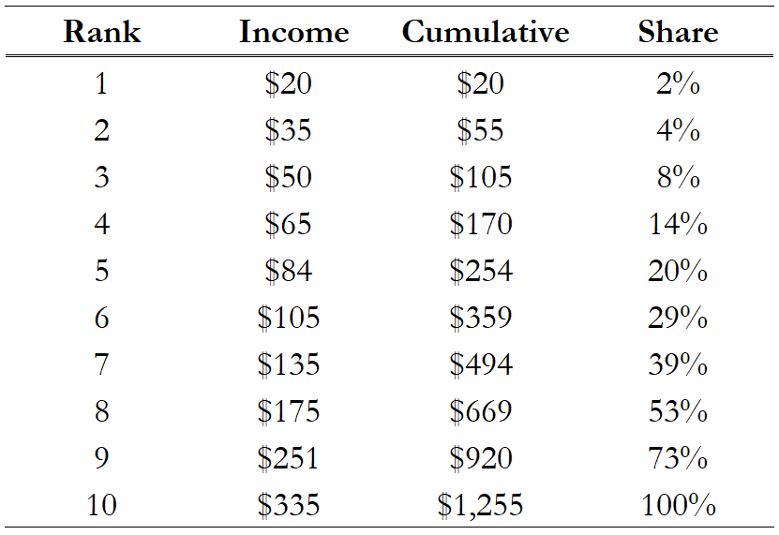
The Lorenz Curve and the Gini Index
Cumulative Income:
The first value of cumulative income is the income of the lowest earner.
The second value of cumulative income is the combined income of the lowest and second-lowest earners.
This process continues until the final value of cumulative income, which is the combined income of all earners.
• We then calculate the share of cumulative income for each successive earner.

Slide 9
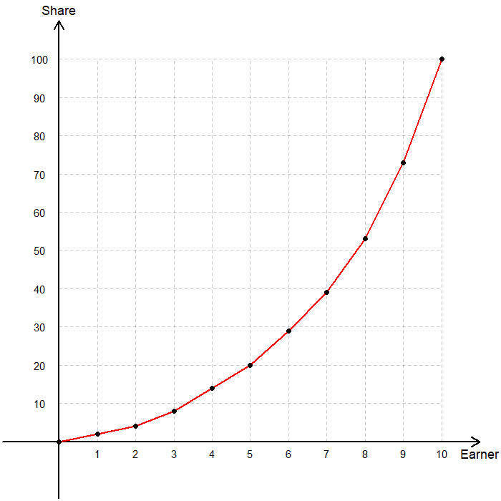
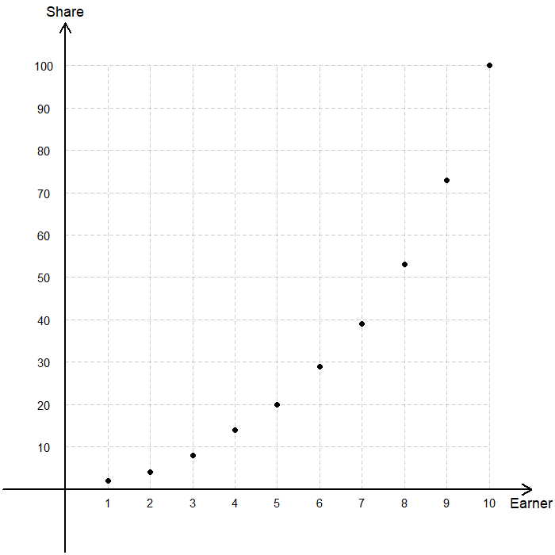
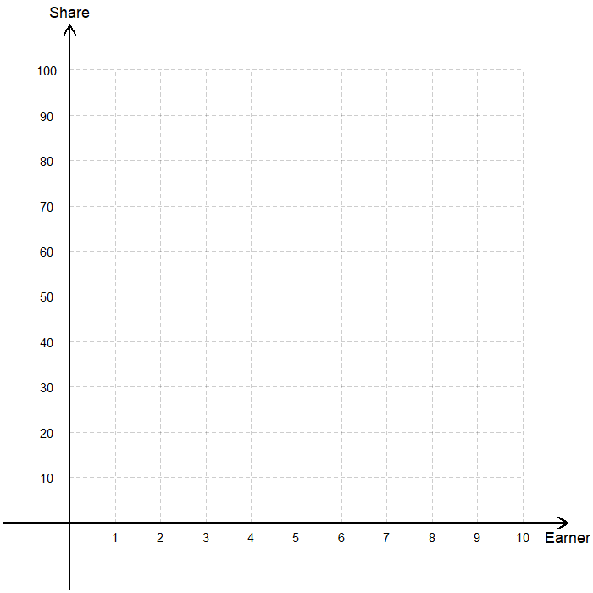
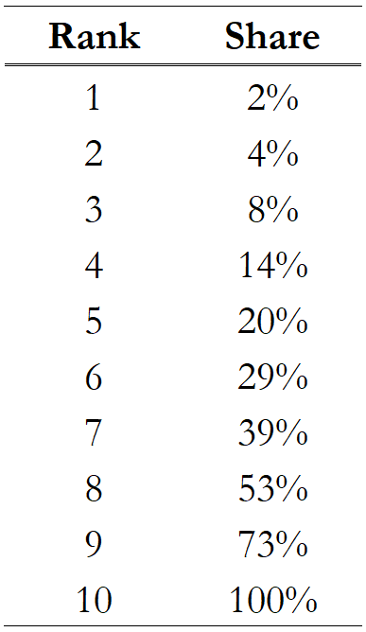
The Lorenz Curve and the Gini Index
Plot the share of income on the vertical axis and the earners on the horizontal axis.
Plot each earner together with that earner’s cumulative share of income from the table.
Connect the points to form the Lorenz Curve, which is a graphical representation of the distribution of income.

Slide 10
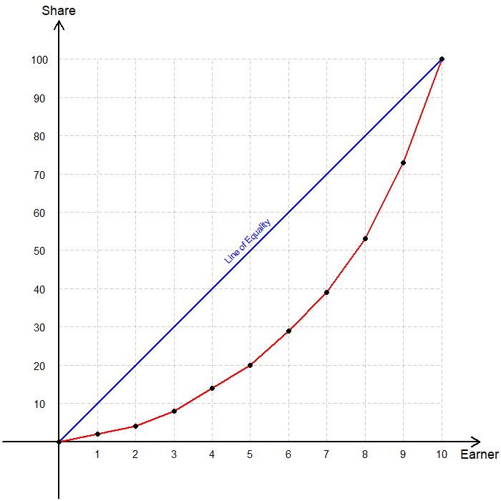
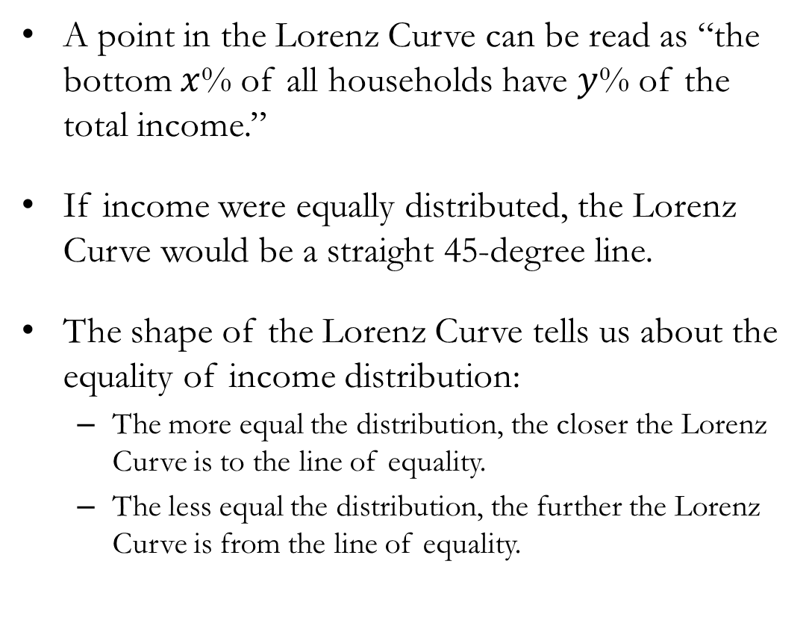
The Lorenz Curve and the Gini Index
A point in the Lorenz Curve can be read as “the bottom $x$% of all households have $y$% of the total income.”
If income were equally distributed, the Lorenz Curve would be a straight 45-degree line.
The shape of the Lorenz Curve tells us about the equality of income distribution:
The more equal the distribution, the closer the Lorenz Curve is to the line of equality.
The less equal the distribution, the further the Lorenz Curve is from the line of equality.

Slide 11
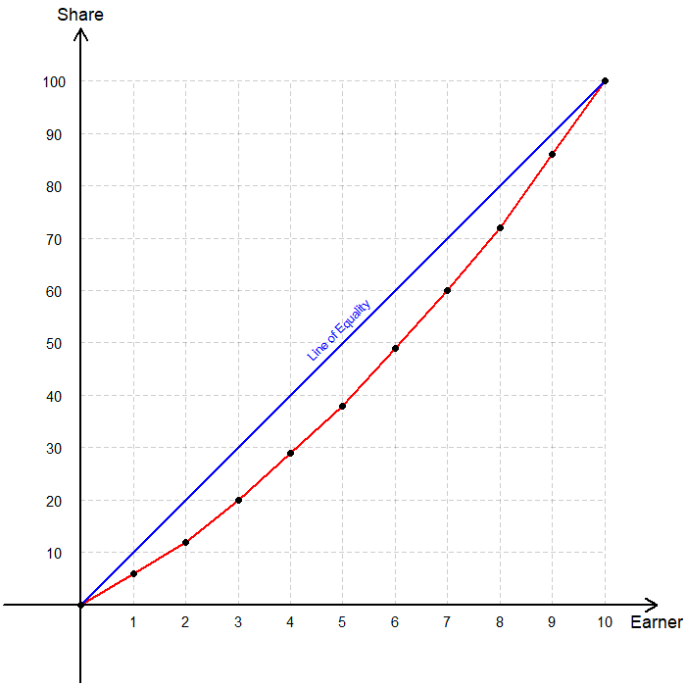
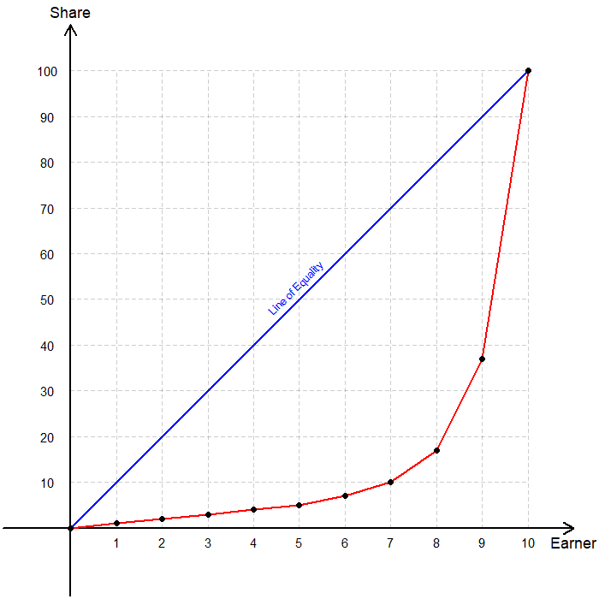
The Lorenz Curve and the Gini Index
More Equal Distribution Less Equal Distribution

Slide 12
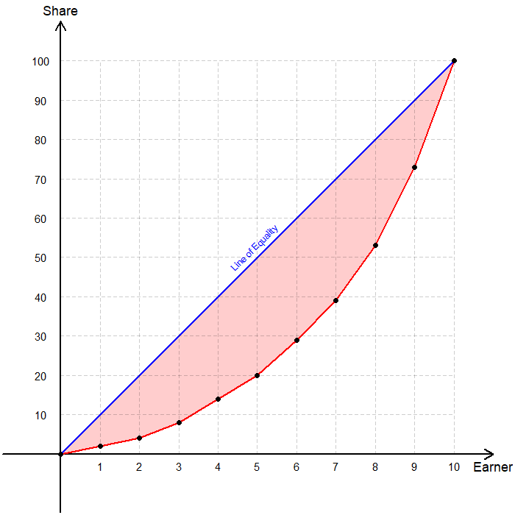
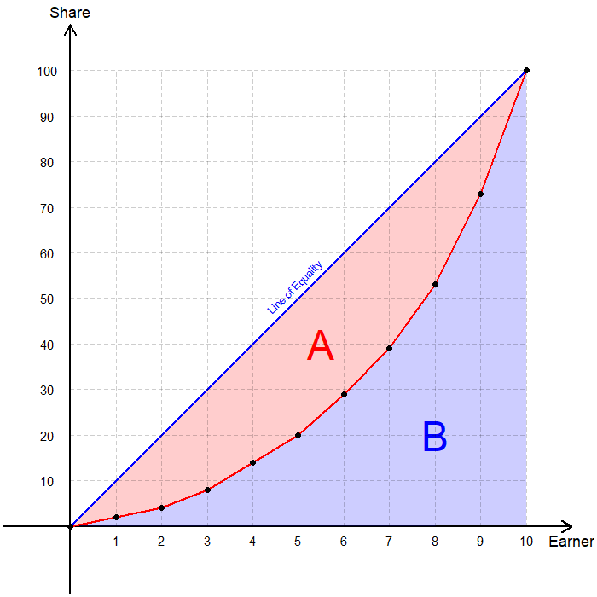

The Lorenz Curve and the Gini Index
Let us name the relevant areas:
A: Area between the Lorenz Curve and the line of equality.
B: The area beneath the Lorenz Curve.
The Gini Coefficient is a widely used measure of income inequality standardized between 0 and 1.
The Gini Index is the Gini Coefficient × 100.
If income is completely equally distributed, the Gini Coefficient is 0.
If income is completely unequally distributed, the Gini Coefficient is 1.
Gini Coefficient = $\frac{\text{A}}{\text{A}\text{+}\text{B}}$

Slide 13
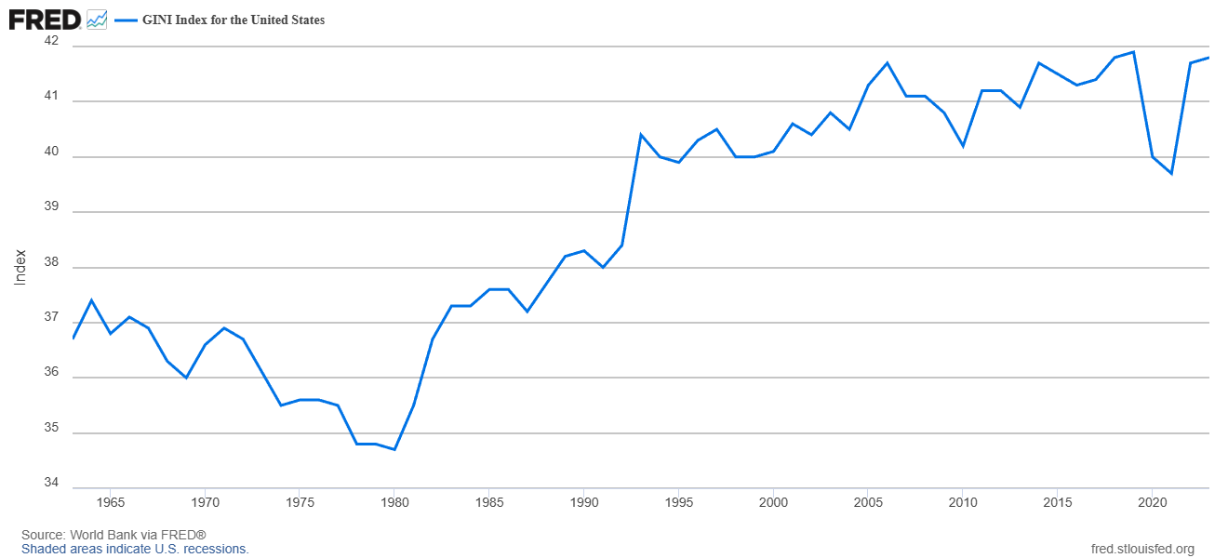
Gini Index: Historical Trend in the U.S.

Slide 14

Limitations: Items Not Measured in Inequality
Demographic and regional discrepancies.
The cause behind the inequality.
The economic mobility of individuals.
Non-monetary sources of well-being.
Temporary versus persistent inequality.
The standard of living for anyone in the economy.
The influence of taxes and in-kind transfers.

Slide 15
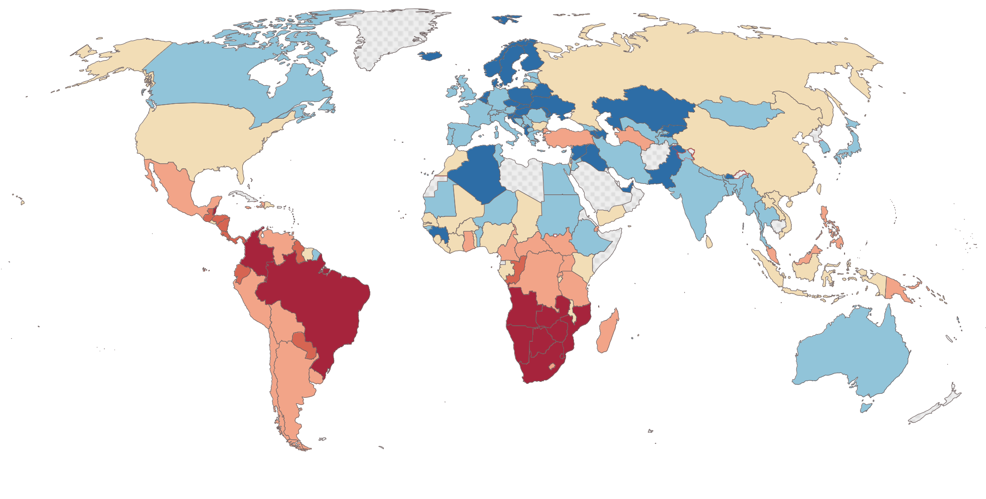
Gini Index: Global Comparison (Income)

Slide 16
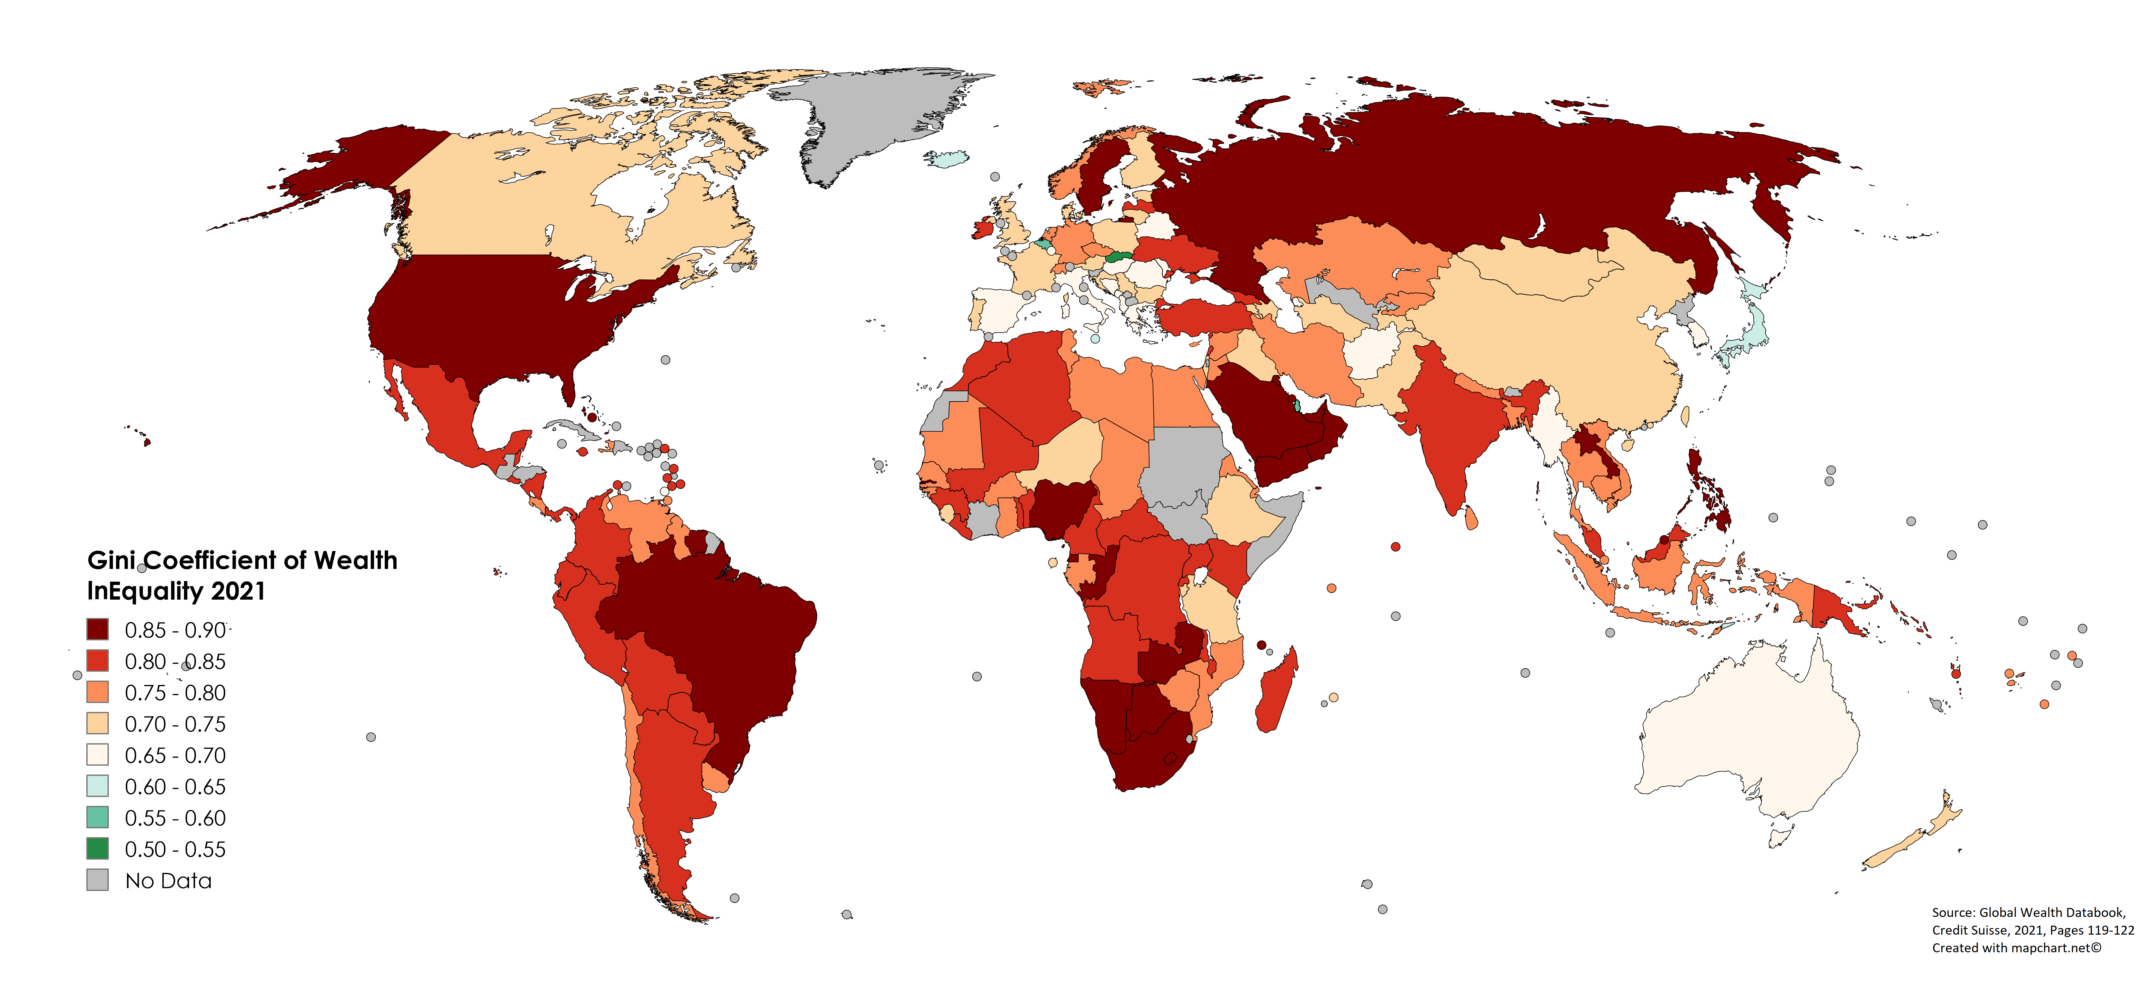
Gini Index: Global Comparison (Wealth)

Slide 17
Stylized Facts on Income Inequality in the U.S.
Income inequality has risen significantly since the 1970s.
The bottom 20% share fell from about 5% to under 4%.
The top 20% share rose from about 43% to nearly 52%.
The quintile ratio and Gini coefficient both show a clear upward trend.
The top of the distribution has captured a large share of income growth.
Real incomes for the top 1% have grown much faster than for the rest of the population.
The share of national income going to the top 1% more than doubled since the late 1970s.
Wages have become more unequal.
High-skill workers (college graduates, especially in STEM) have seen stronger wage growth.
Middle-skill manufacturing and clerical jobs have experienced slow or negative real wage growth.
The minimum wage has not kept pace with inflation.

Slide 18
Stylized Facts on Income Inequality in the U.S.
Wealth inequality is far more extreme than income inequality.
The top 10% of households own more than two-thirds of all wealth.
The top 1% alone own more wealth than the bottom 90% combined.
Wealth inequality has grown faster than income inequality.
Geographic inequality has increased.
High-income, high-skill regions (such as coastal cities) have pulled ahead.
Rural regions and small towns have experienced slower wage and employment growth.
Intergenerational mobility is lower than in many peer countries.
Children born into low-income families are less likely to move up the income distribution compared to children in Canada or Western Europe.
Inequality of opportunity reinforces income inequality over time.

Slide 19
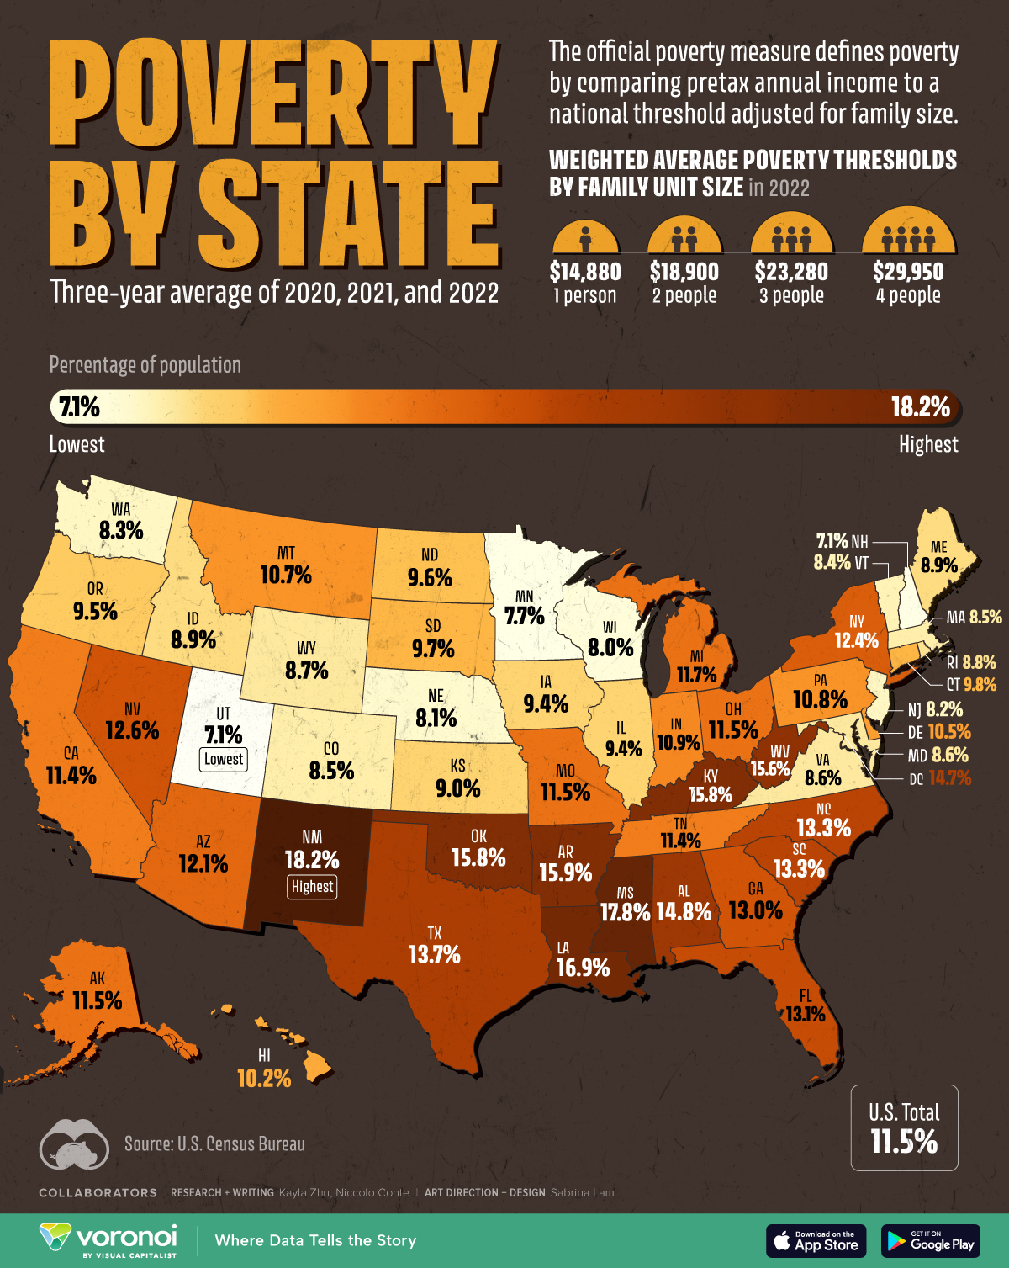
Poverty
The Poverty Line is an absolute level of income set by the federal government for each family size, below which a family is considered to be in poverty.
The Federal poverty line as of 2025 is:
$15,650 for a family of one.
$21,150 for a family of two.
$26,650 for a family of three.
$32,150 for a family of four.
$37,650 for a family of five.
The poverty line is updated every year to account for changes in the economy’s price levels.

Slide 20
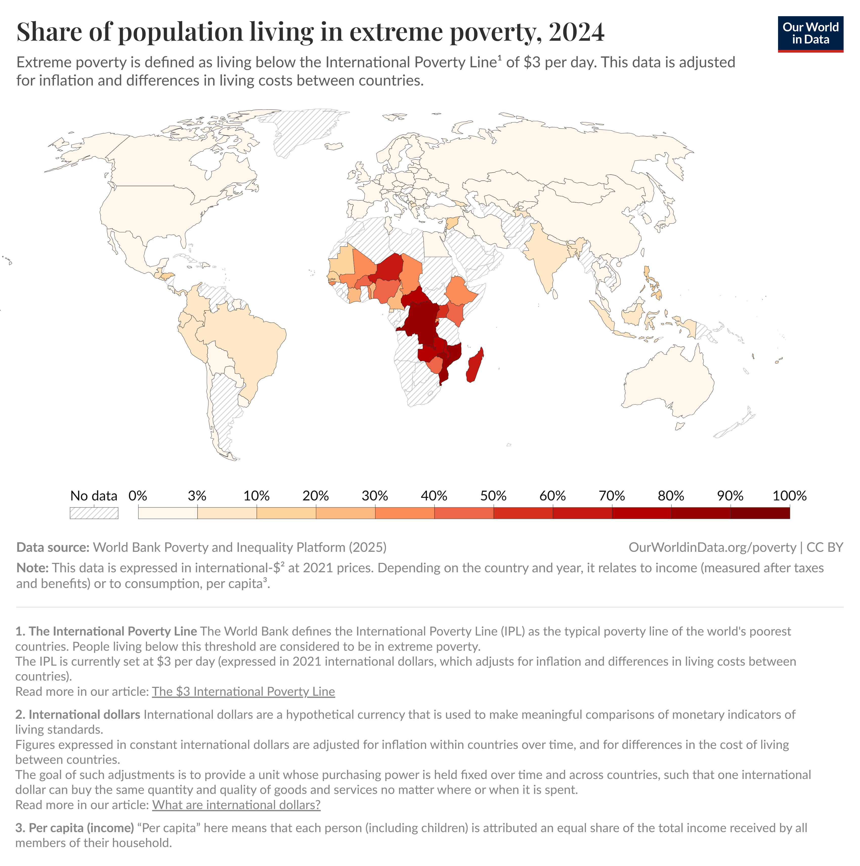
Poverty Rate
In 2023, the World Bank set the International Poverty Line (IPL), the global absolute minimum, at $2.15 per day.
The Poverty Rate is the share of the population whose family income falls below the poverty line.
In 2023, the poverty rate of the United States was estimated to be 11.1%, which amounts to about 37 million people living in poverty.
In 2025, it is estimated that 808 million people globally live on less than $3 per day, for a global poverty rate of 9.9%.

Slide 21
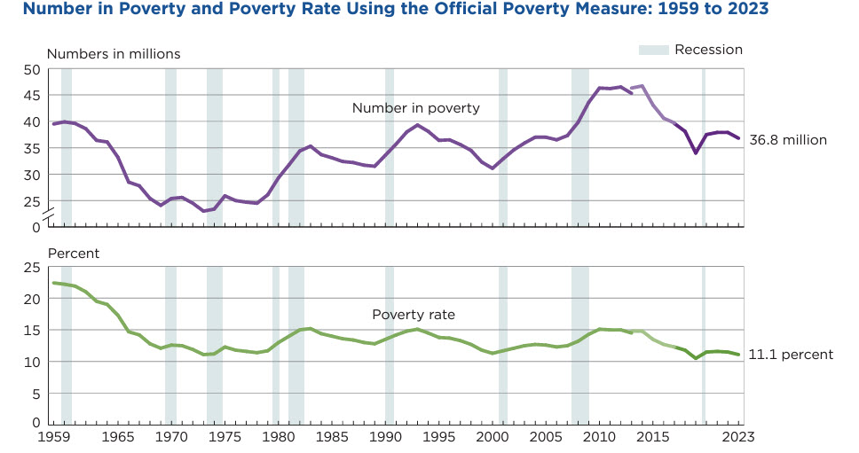
Poverty Rate: Historical Trend in the U.S.

Slide 22
Stylized Facts on Poverty in the U.S.
The U.S. poverty rate has been relatively stable for decades.
The national poverty rate has generally fluctuated between 10% and 15% since the 1970s.
Economic expansions reduce poverty modestly, while recessions increase it.
Roughly 5% of the population lives in “deep poverty,” defined as income below 50 percent of the poverty line.
Regional differences in poverty are large.
The South has the highest poverty rates, especially in states such as MS, LA, AR, and NM.
The Northeast and Midwest tend to have lower poverty rates.
Rural areas also experience higher poverty rates than urban areas
Poverty rates differ sharply by race and ethnicity.
Black and Hispanic households have poverty rates notably higher than White and Asian households.
These gaps have narrowed somewhat over time but remain persistent

Slide 23
Stylized Facts on Poverty in the U.S.
Children experience higher poverty rates than adults.
Children under 18 consistently have the highest poverty rates of any age group.
Senior poverty has declined substantially since the 1960s due to Social Security expansions.
Single-parent families face much higher poverty rates.
Households headed by a single mother have among the highest poverty rates in the country.
Married-couple families have much lower rates.

Slide 24
Redistributing Income

Slide 25
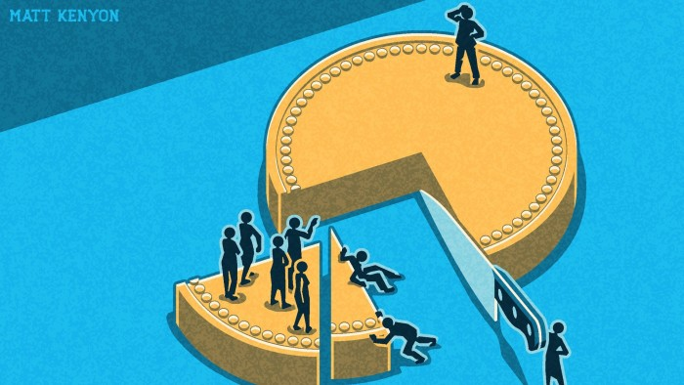
Political Philosophies of Income Redistribution
We now turn to a normative question: “what should society do about economic inequality?”
Income Redistribution refers to the transfer of income or wealth from one group to another aiming to reduce inequality.
Let’s examine some political philosophies of redistributing income:
Utilitarianism
Liberal Contractarianism
Libertarianism

Slide 26
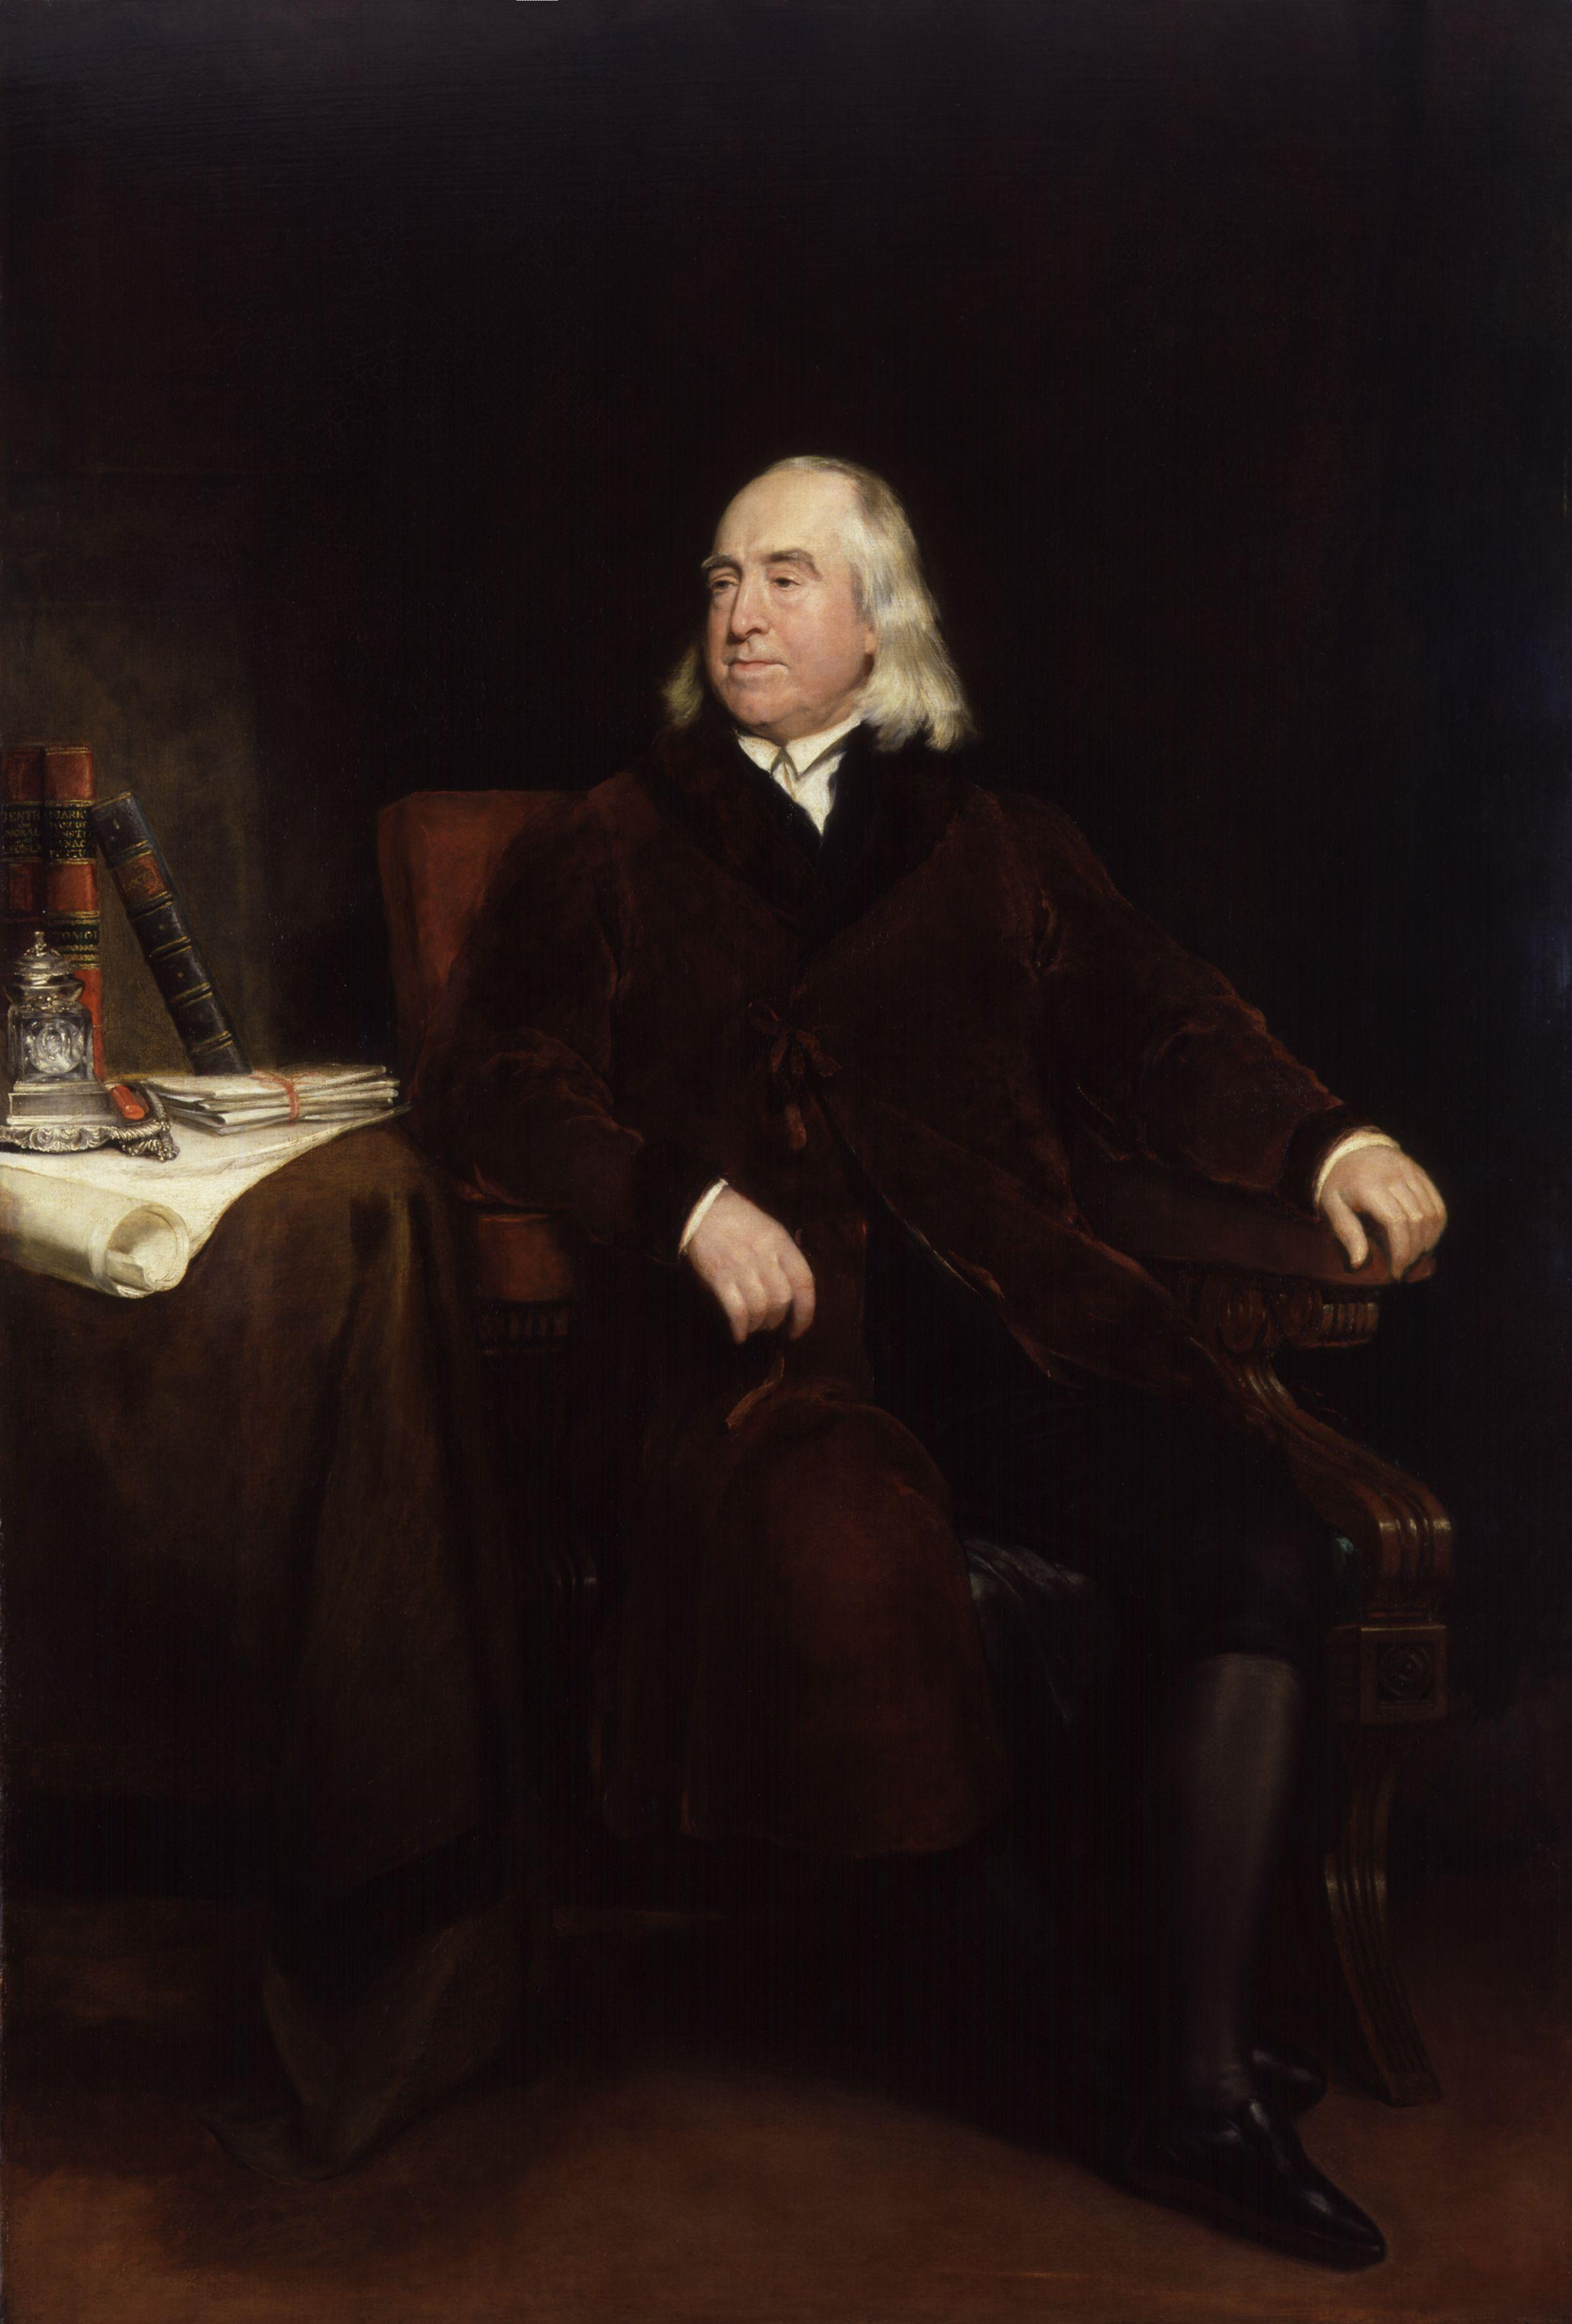
Utilitarianism
“The greatest good for the greatest number.”
Utility is a measure of subjective satisfaction.
Utilitarianism is the political philosophy that posits that a policy maximizing the total utility of everyone in society is just.
Standard assumption: Diminishing Marginal Utility
As a person consumes more of a good or service, the additional utility gained from each extra unit decreases.
The additional utility a billionaire would receive from $100 is smaller than the utility a person in poverty would receive from the same $100.
This provides a classic argument for why redistributing income from the rich to the poor can increase total utility.

Slide 27
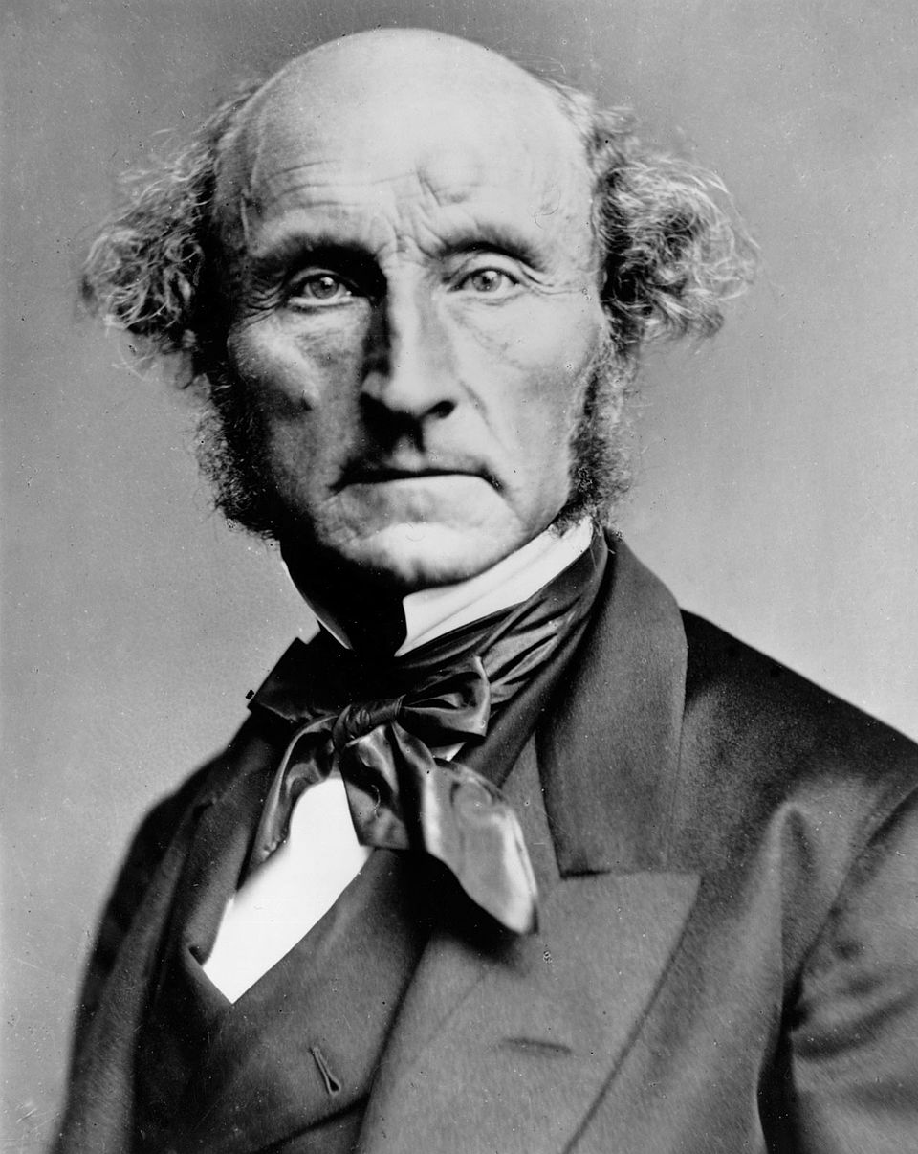
Utilitarianism
Yet utilitarians reject the idea of completely equalizing incomes.
People respond to incentives:
If everyone’s income were equalized, incentives to work and innovate would fall for everyone.
High earners facing very high tax rates would lose, at least partially, the motivation to continue working hard.
Those receiving transfers would lose, at least partially, the motivation to work at all.
In the medium to long run, completely equalizing all incomes would lead to lower total income for society.

Slide 28

Liberal Contractarianism
Liberal Contractarianism is the view that the government should choose policies that impartial observers would judge to be just.
Decisions are made behind a Veil of Ignorance, with no knowledge of one’s place in society:
Without knowing one’s income or wealth
Without knowing one’s race or ethnicity
Without knowing one’s gender or religion
Without knowing one’s talents or disabilities
Removing knowledge of your personal characteristics forces you to choose principles that are fair to everyone.

Slide 29
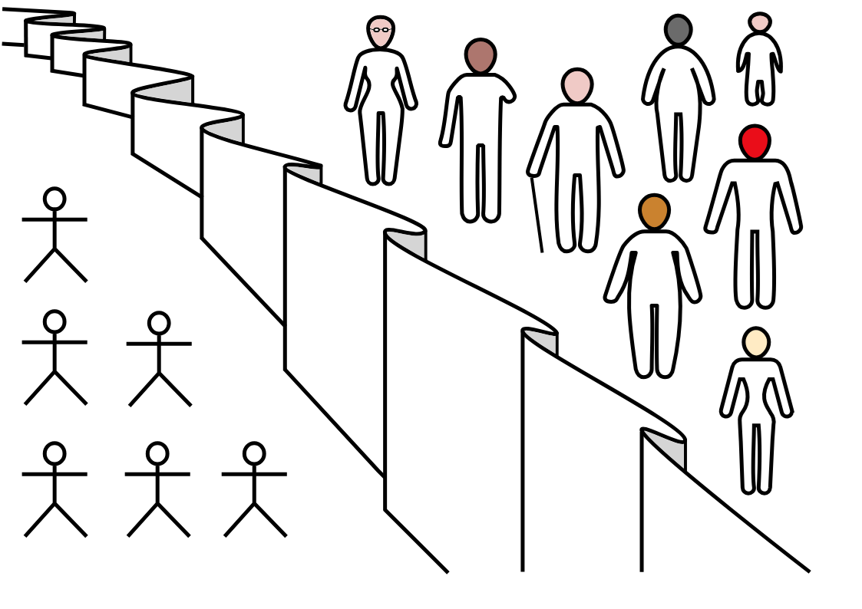
Liberal Contractarianism
The veil of ignorance would lead decision makers to adopt the Maximin Principle.
Maximin Principle
Aims to maximize the well-being of the worst-off person in society.
Allows inequalities only if they satisfy the “difference principle,” meaning the inequalities improve the situation of the least advantaged.
Liberal contractarianism would support income redistribution as a form of social insurance.

Slide 30
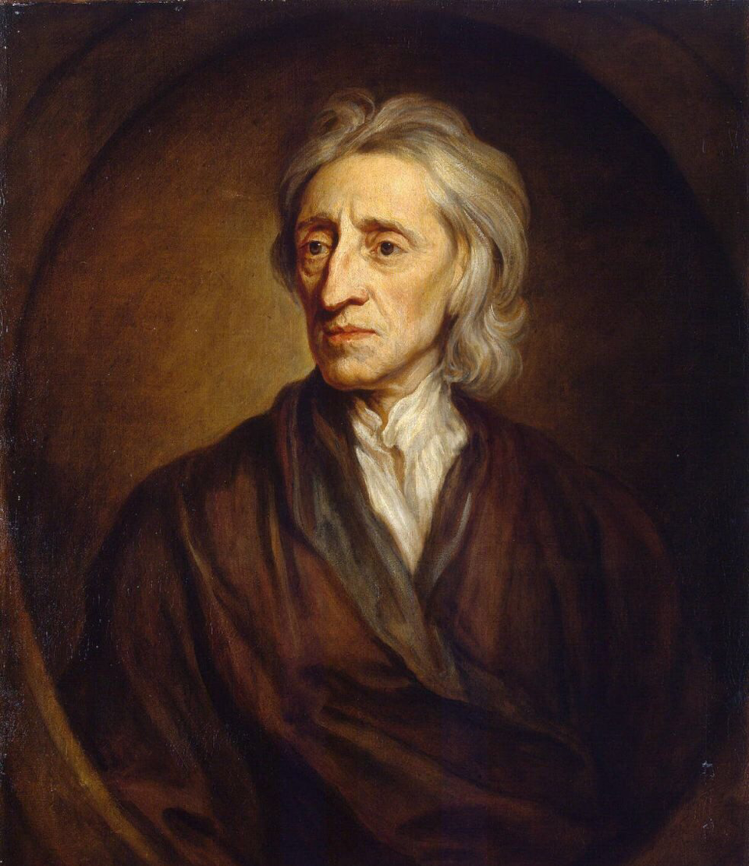
Libertarianism
Libertarianism is a political philosophy that prioritizes individual liberty, personal autonomy, and a limited government.
Libertarians focus on establishing a just process rather than the outcomes:
Libertarians argue that the government’s role is to enforce individual rights and guarantee an equal opportunity for all.
As long as the distribution of income results from fair and voluntary exchanges, the government should not intervene, even if the outcome is unequal.

Slide 31
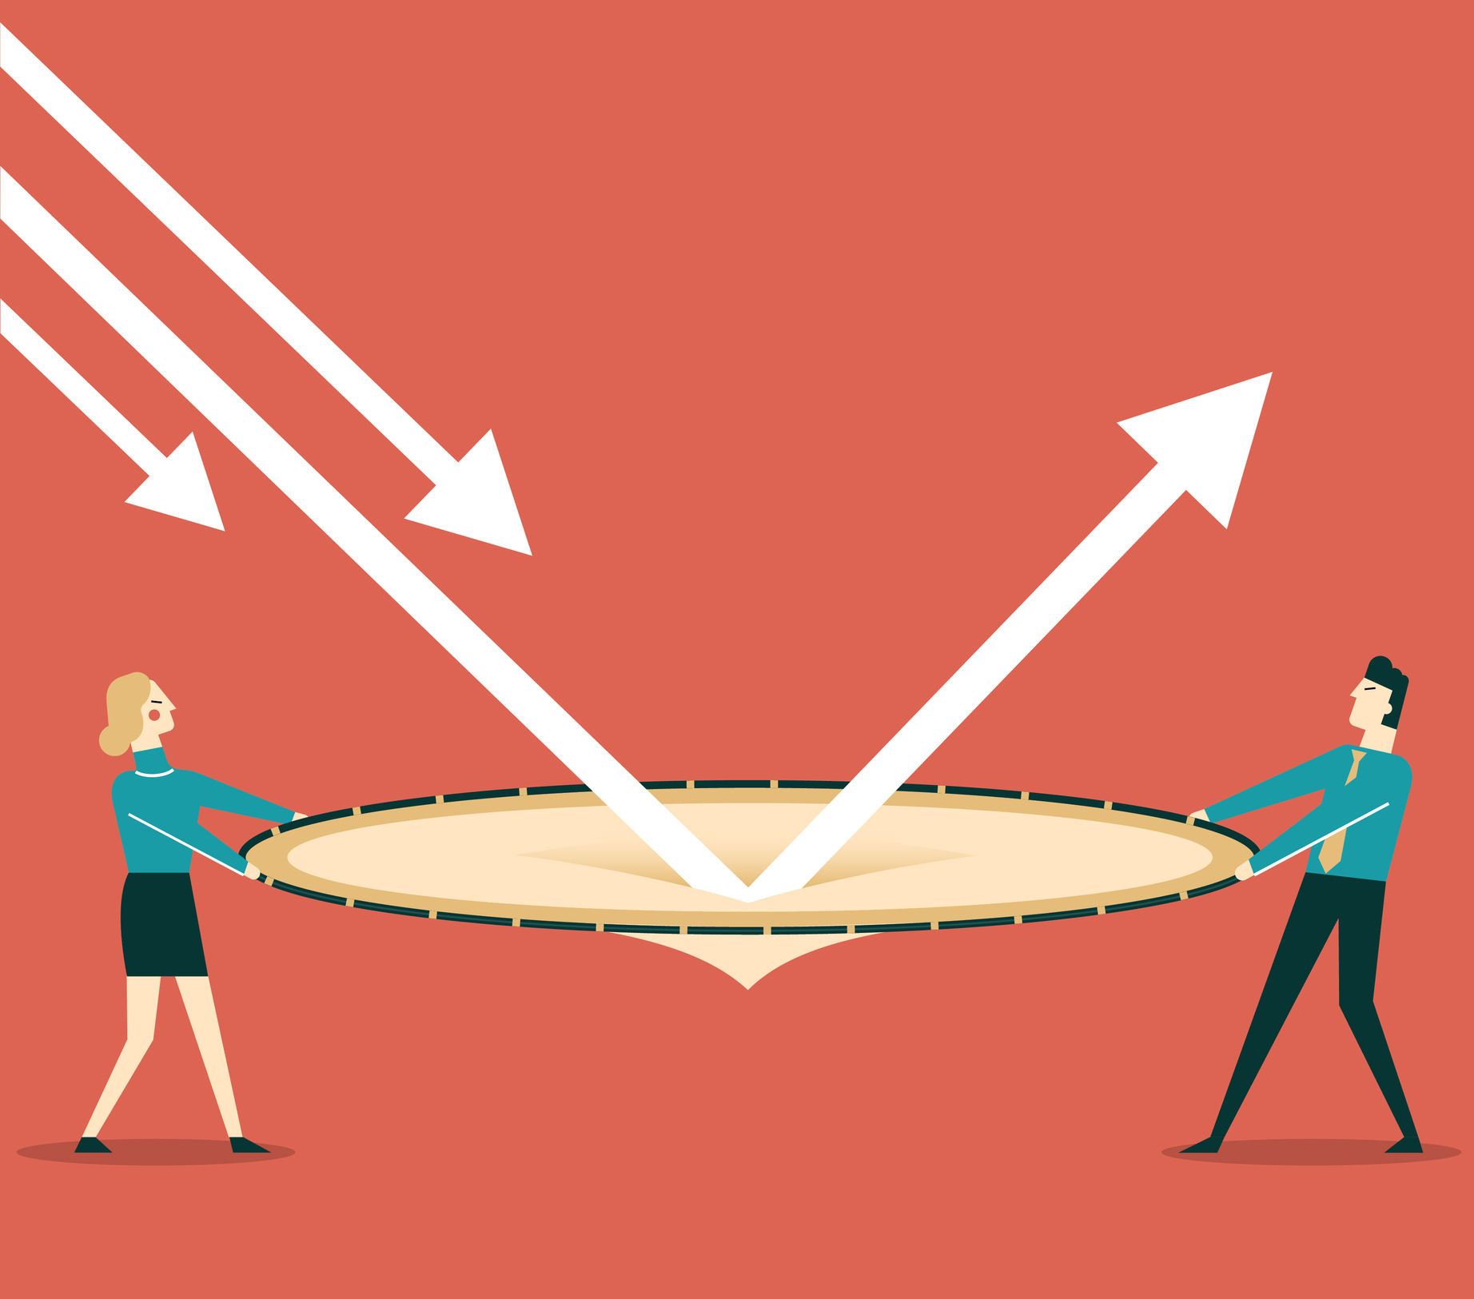
Policies to Reduce Poverty
Policies involving income redistribution can be controversial.
Surveys show that most Americans support the government providing a basic safety net for people facing poverty or severe hardship.
Some examples include:
Minimum Wage Legislation
Welfare Programs
Negative Income Tax
In-Kind Transfers

Slide 32
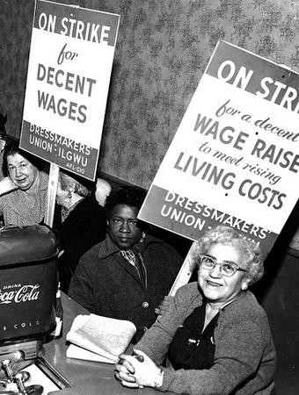
Minimum Wage Legislation
A Minimum Wage is the lowest remuneration that employers can legally pay their employees.
Pro:
Helps the working poor without any direct cost to the government.
Has little impact on employment when the demand for labor is inelastic.
Con:
If labor demand becomes elastic in the long run, higher minimum wages can lead to higher unemployment.
Poorly targeted, since many minimum-wage beneficiaries are teens from middle-income families rather than low-income adult workers

Slide 33
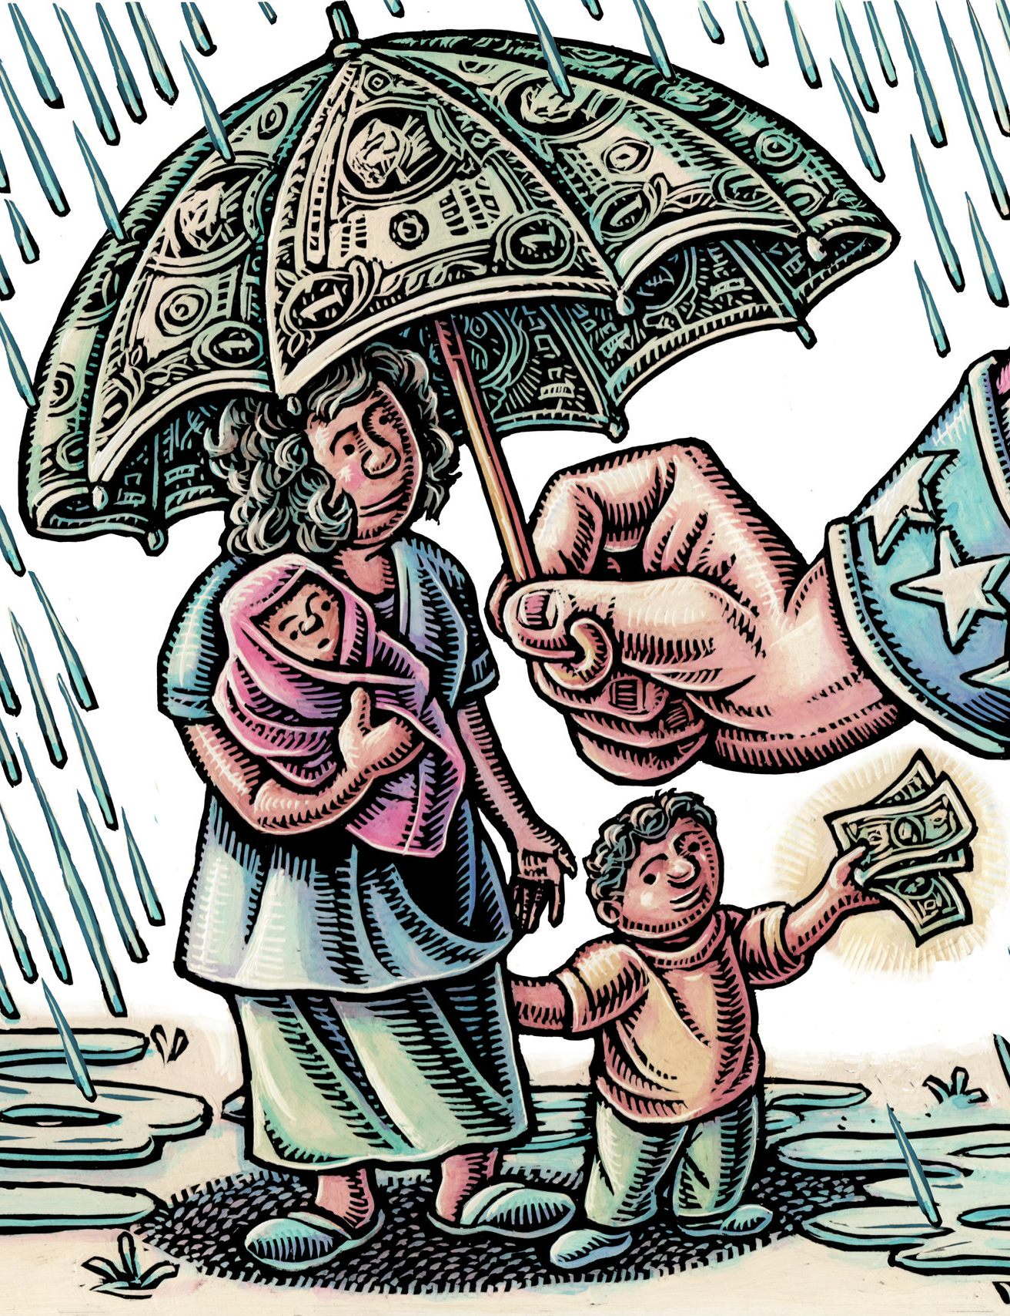
Welfare Programs
Welfare Programs are government programs that supplement the incomes of households in need.
TANF: Temporary Assistance for Needy Families
SSI: Supplemental Security Income
Critics argue that welfare programs may create unintended incentives for those who might qualify.
e.g., “Welfare programs targeted at single-parent households may unintentionally incentivize family breakup.”
Proponents argue that such concerns are overstated, since most people would not deliberately worsen their circumstances to qualify for assistance.
e.g., “Restrictions placed on welfare programs did not reduce the percentage of children living with one parent.”

Slide 34
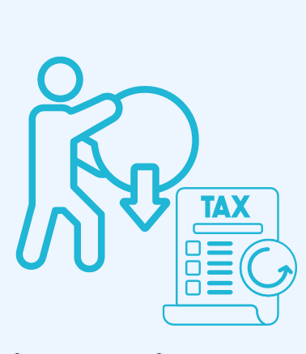
Negative Income Tax
A Negative Income Tax is a tax system that collects revenue from high-income households and gives subsidies to low-income households.
Example:
Income Tax Owed = (1/2 of Income) - $20,000
Households earning $10,000 “owe” -$15,000 in income tax.
Households earning $30,000 “owe” -$5,000 in income tax.
Households earning $100,000 owe $30,000 in income tax.
The Earned Income Tax Credit (EITC) is a U.S. program that works similarly as a negative income tax.

Slide 35
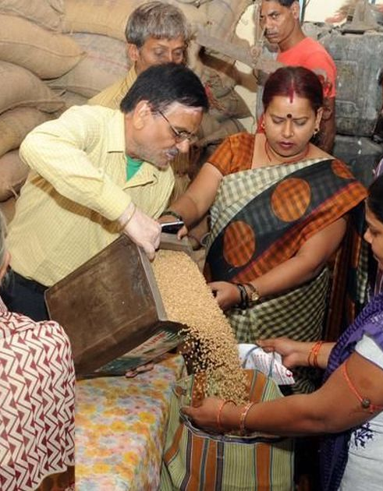
In-Kind Transfers
An In-Kind Transfer refers to providing assistance in the form of specific goods or services rather than cash.
Cash transfers are an alternative, but some argue that cash benefits can be spent on items that may not directly improve living standards.
Supporters of in-kind transfers argue that providing essentials such as food, housing, or medical care ensures that assistance directly meets basic needs.
Examples:
SNAP: Supplemental Nutrition Assistance Program
Medicaid

Slide 36

Detour: In-Kind vs. Cash Transfers
In-kind assistance works as well as cash only if it gives people exactly what they would have chosen for themselves.
Someone might pay $20 for a gift they give a loved one.
The gift is truly worth $20 only if the recipient would have purchased that same item had they instead received $20 in cash.
If the recipient’s willingness to pay for the item is only $15, then $5 of value is lost due to the in-kind transfer.
Dr. Joel Waldfogel estimates that about 10% of the value of Christmas gifts is lost because recipients value them less than what givers paid: “the Deadweight Loss of Christmas.”

Slide 37
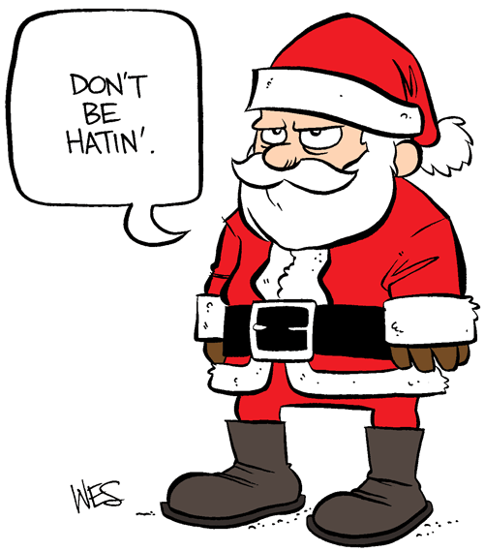
Detour: The Deadweight Loss of Christmas?
Of course, this should be taken “for fun.”
The study treats willingness to pay as the sole measure of value and ignores any non-market values.
e.g., Parents’ most prized possession may be a poor-quality ceramic cup they received as a gift from their child.
It does not consider the “discovery” effect that gifts can have on relaxing information constraints.
e.g., Someone may pick out an item you did not even know existed, which can greatly improve your quality of life.
The author also assumes that recipients would always spend cash optimally, and several other limitations exist.

Slide 38
Antipoverty Programs and Work Incentives
Antipoverty programs often have the unintended effect of discouraging people from escaping poverty on their own because assistance declines as income increases.
Consider this poorly designed welfare program:
A program grants $13,000 to families earning less than $25,000.
As soon as the household income exceeds $25,000, the household is no longer eligible.
Working 20 extra hours per week raises disposable income by only $2,600.
 | Work Less | Work More | Difference
Hourly Wage | $15 | $15 | $0
Hours Worked | 20hr/week | 40hr/week | +20hrs/week
Labor Income | $15,600 | $31,200 | +$15,600
Welfare Benefits | $13,000 | $0 | -$13,000
Disposable Income | $28,600 | $31,200 | +$2,600

Slide 39
Antipoverty Programs and Work Incentives
Policymakers must take care when designing antipoverty programs so that they do not discourage recipients from escaping poverty.
One method is to gradually reduce benefits as household income rises.
This reduces the discouraging effect of working additional hours.
It comes at the cost of making the program more expensive to administer.
Another method is to add work requirements to welfare programs.
Many U.S. programs (e.g., SNAP, TANF, the EITC, and some Housing Assistance programs) require recipients to be employed or actively seeking employment to receive benefits.
Providing welfare for a limited period of time is another method used to incentivize work.

Slide 40
Recap of Chapter 21

Slide 41
Recap
Income Inequality
Inequality describes how income is distributed across individuals or groups.
Earnings can be compared using quintiles (bottom 20% to top 20%).
The Quintile Ratio compares the income share of the top quintile to the bottom quintile.
The Lorenz Curve plots cumulative income distribution across the population.
The Gini Coefficient also measures inequality:
0 = perfect equality
1 = perfect inequality
While useful, these measures of income inequality fail to capture many crucial aspects of inequality.
U.S. inequality has increased since the 1970s
Inequality varies by region, skill level, and demographic group

Slide 42
Recap
Poverty
The Poverty Line is an absolute income threshold varying by family size.
The Poverty Rate is the share of individuals below this threshold.
U.S. poverty has remained between 10–15% since the 1970s.
Poverty rates differ by region, race/ethnicity, and family structure.
Children and single-parent households experience the highest poverty rates.
Redistribution & Policy Tools
Three philosophies: Utilitarianism, Liberal Contractarianism, Libertarianism
Policy approaches may include minimum wage laws, welfare programs, negative income tax, or in-kind transfers.
Poorly designed programs can create work disincentives.
Gradual phase-outs and work requirements can improve incentives

